Slide 1

New customer plan

Slide 2
What we did
As planned, customer demographic and customer address information spreadsheets were merged and further analysis took place in Tableau.
We analyzed the demographics of customers both who have made the most purchases in the last year and also those who have made the most high values purchases (from transactions data).
We found the same results from both analysis and therefore will not present them both separately

Slide 3
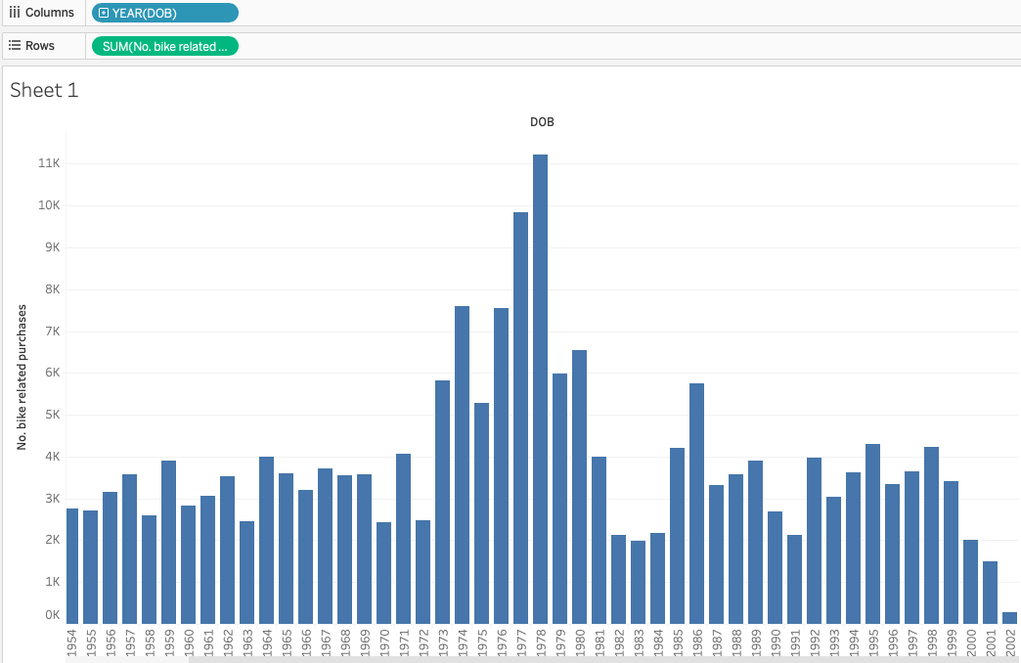
People born in 1977 and 1978 make the most bike related purchases
From reading other research, this agrees with the fact that avid cyclists tend not to be young adults.

Slide 4
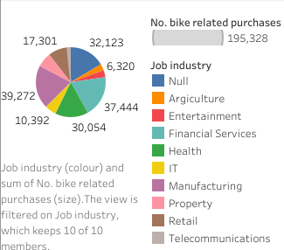
People who work in Manufacturing and Financial Services make the most bike related purchases
Null is very large here too. This group could possibly be students who are know (from reading other sources) to use bicycles as transport quite a big. It would be good to collect further information on this ‘null group’

Slide 5
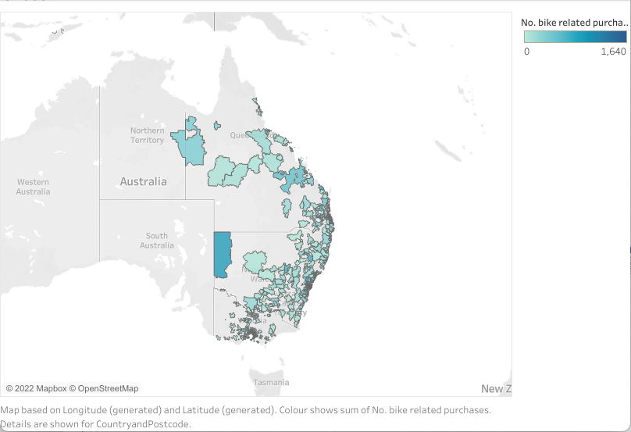
People in the postcode 2880 make the most bike related purchases

Slide 6
Action plan
Attached you will find a list of 442 customers taken from your new customer list. These customers have the attributes listed on the previous 3 slides. These are the best new customers to target with advertisements.
Alternatively you could target new customers with the most bike related purchases over the past 3 years, as we seemed to find these customers were also buying high value products.

